Slide 1
IBM Bluemix
Building your own survey response application

Slide 2

Are you ready to develop in the cloud?

Slide 3
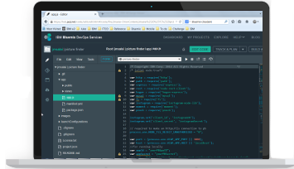






First you will need a Bluemix and JazzHub account. You can sign up for one here
IDE
Next you will go to JazzHub and download the code.
Build
Develop
Built Artifacts
Deliver
Request Build
SCM

Slide 4



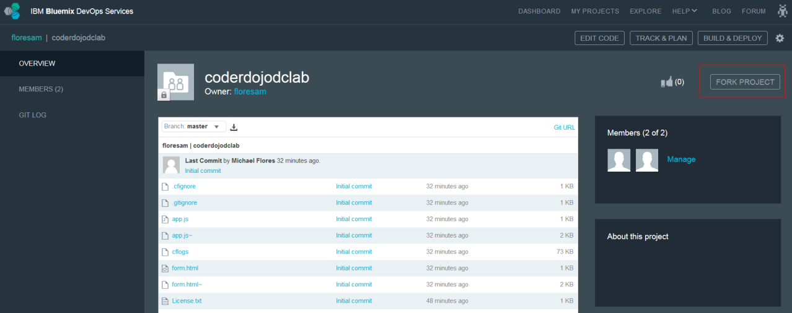
The code we are looking for is available here
IDE
Build
Develop
Built Artifacts
Deliver
Request Build
SCM
To create a copy of the code, you will click the “Fork Project” button
Notes:
https://hub.jazz.net/project/floresam/coderdojodclab/overview

Slide 5

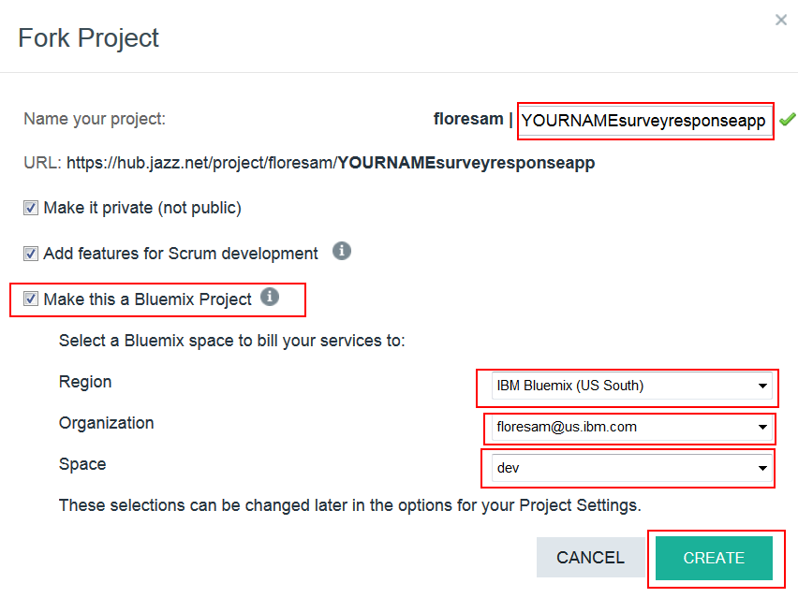
You now have to name your new project and it’s destination
Name your project “YOURNAME-survey-response-app”—make sure to replace YOURNAME with your name.
Make this a Bluemix project should be checked
Region should be set to IBM Bluemix(US South)
Organization should match YOUR Bluemix and Jazzhub account e-mail address
Space should be set to dev
Click Create

Slide 6

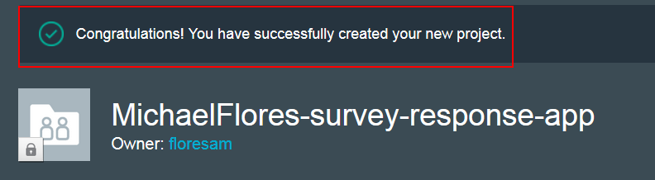
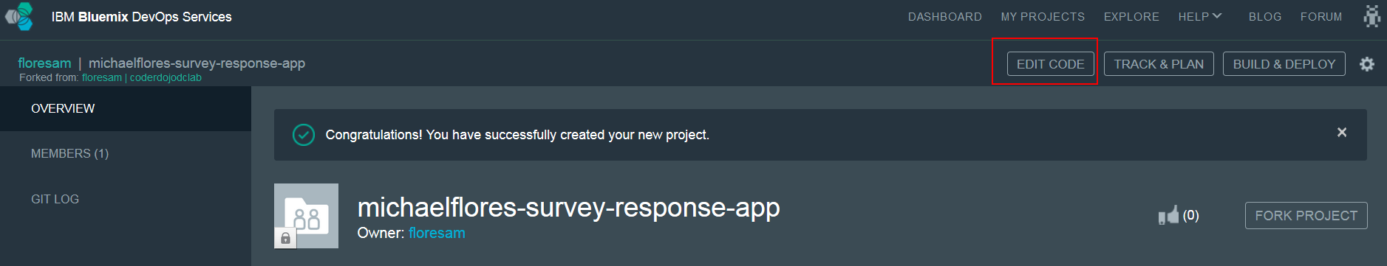
If you see the following message, you now have your own version of the code for the Survey Response app!
Remember how we checked the box to “Make this a Bluemix project”? That means that our new app is ready for Bluemix
To begin the deployment process, click on the “Edit Code” button for your new project

Slide 7
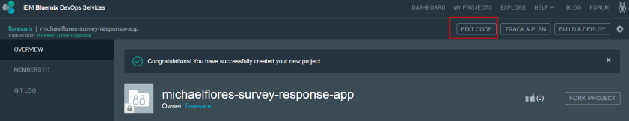
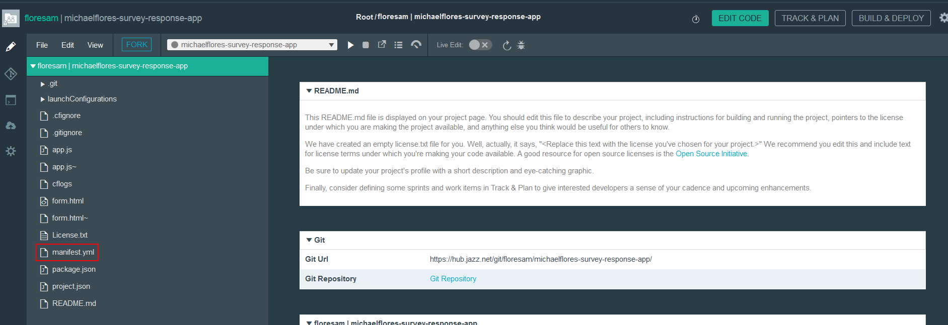
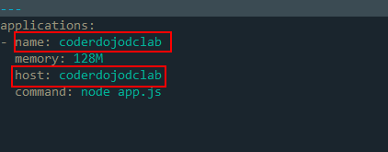
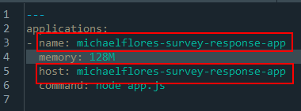
From the “Edit Code” view, you can see all the files and code in your new app.
Click on the file “manifest.yml”. This file contains instructions telling Bluemix how to deploy your app.
We need to change both ‘name’ and ‘host’ to match YOUR project name.

Slide 8
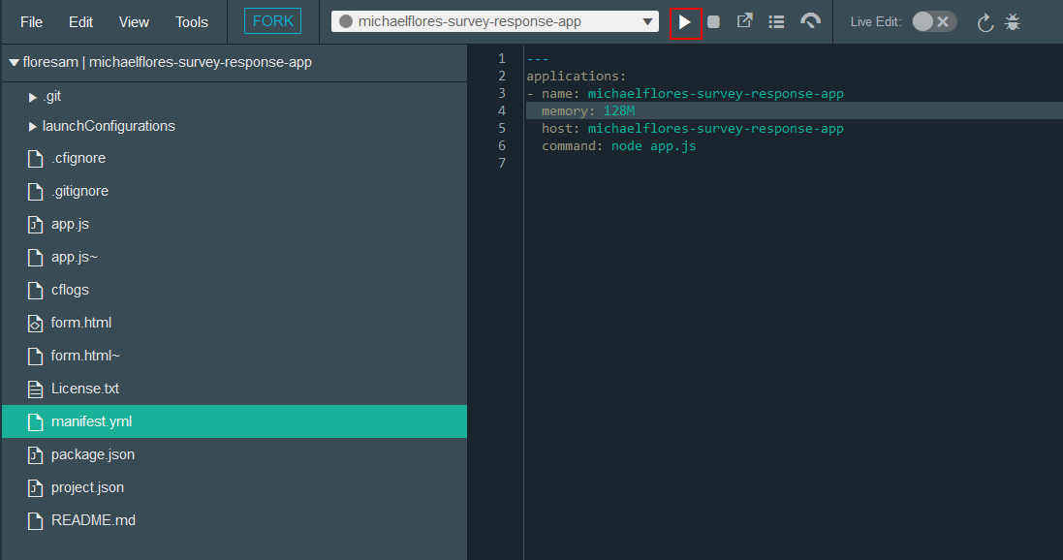
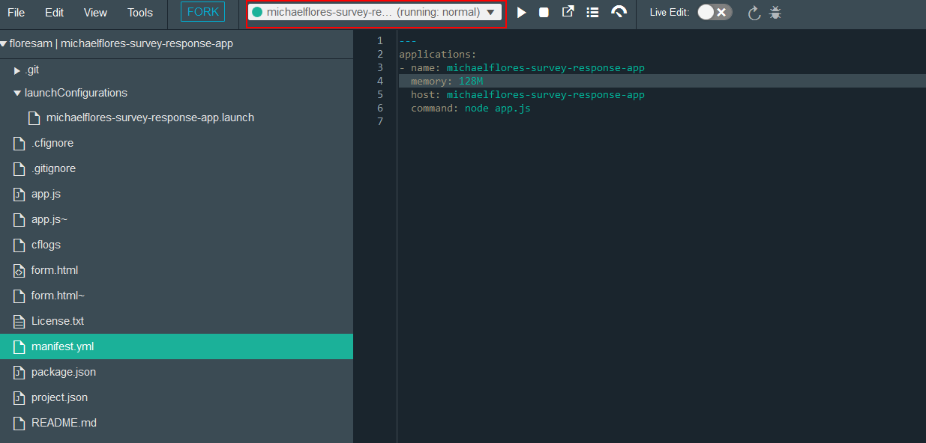
Our app is now ready to rock!
Click on the white play arrow to deploy your application to Bluemix!
When the circle turns green and the text bar says (running: normal), our app has finished deploying!

Slide 9
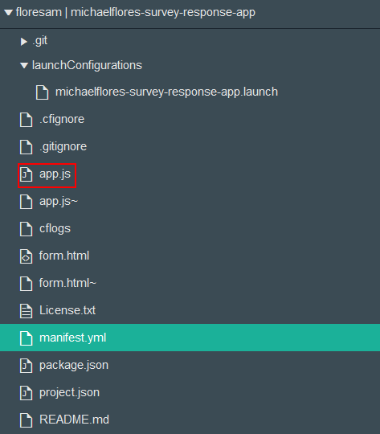
Let’s go check out your app!
To see your app, click on the white square with an arrow on it. This will open up a new web page directed to your app.
This doesn’t seem right! Let’s go back to our code view and look at our code.
In our project, app.js contains the main logic of our app. Click on it and let’s take a look.

Slide 10

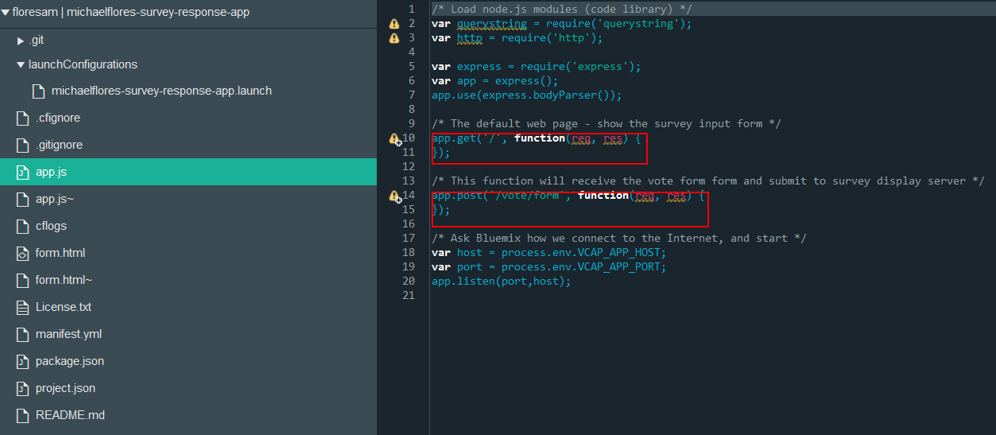
I knew it! Someone must have stolen the code from your app!
Luckily I always keep a backup! Let’s try copying the missing code into your app.

Slide 11
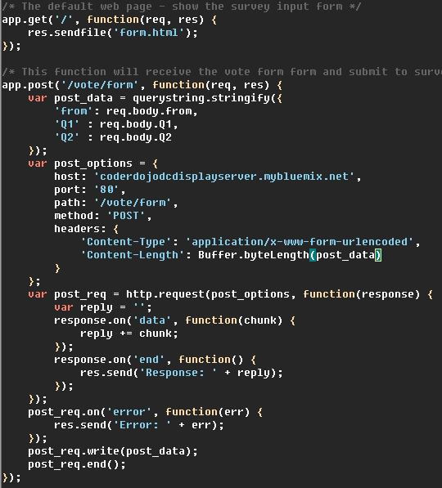
If memory serves, the code went something like this…
When someone uses our app, we send them the form in ‘form.html’ using a get call.
When someone submits the form, we extract and send their responses to our displayserver to tally results using a post call.
I put the code in this presentation’s speaker notes for you too!
Notes:
/* The default web page - show the survey input form */
app.get('/', function(req, res) {
res.sendfile('form.html');
});
/* This function will receive the vote form form and submit to survey display server */
app.post('/vote/form', function(req, res) {
var post_data = querystring.stringify({
'from': req.body.from,
'Q1' : req.body.Q1,
'Q2' : req.body.Q2
});
var post_options = {
host: 'coderdojodcdisplayserver.mybluemix.net',
port: '80',
path: '/vote/form',
method: 'POST',
headers: {
'Content-Type': 'application/x-www-form-urlencoded',
'Content-Length': Buffer.byteLength(post_data)
}
};
var post_req = http.request(post_options, function(response) {
var reply = '';
response.on('data', function(chunk) {
reply += chunk;
});
response.on('end', function() {
res.send('Response: ' + reply);
});
});
post_req.on('error', function(err) {
res.send('Error: ' + err);
});
post_req.write(post_data);
post_req.end();
});

Slide 12
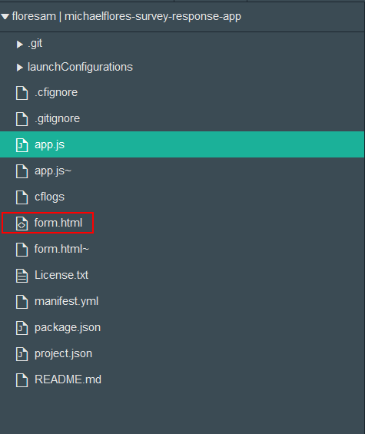
Ahh… much better.
While we’re at it, let’s go take a look at our form… I made it myself!

Slide 13
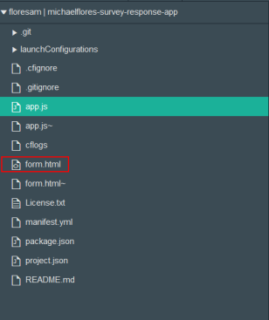
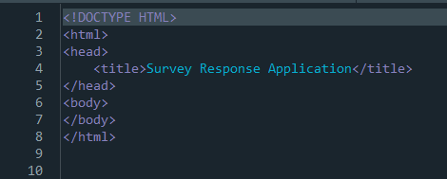
Looks like they got the form too!
It’s alright though, I know this one like the back of my claw

Slide 14
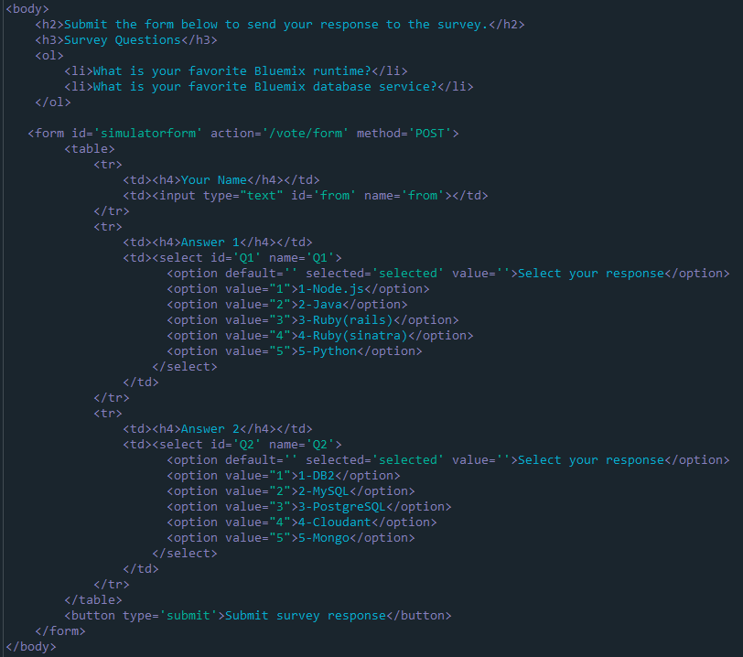
These forms sure are tricky.
This <body> code needs to go after </head> and before </html>
I put the code in this presentation’s speaker notes for you too!
Notes:
<body>
<h2>Submit the form below to send your response to the survey.</h2>
<h3>Survey Questions</h3>
<ol>
<li>What is your favorite Bluemix runtime?</li>
<li>What is your favorite Bluemix database service?</li>
</ol>
<form id='simulatorform' action='/vote/form' method='POST'>
<table>
<tr>
<td><h4>Your Name</h4></td>
<td><input type="text" id='from' name='from'></td>
</tr>
<tr>
<td><h4>Answer 1</h4></td>
<td><select id='Q1' name='Q1'>
<option default='' selected='selected' value=''>Select your response</option>
<option value="1">1-Node.js</option>
<option value="2">2-Java</option>
<option value="3">3-Ruby(rails)</option>
<option value="4">4-Ruby(sinatra)</option>
<option value="5">5-Python</option>
</select>
</td>
</tr>
<tr>
<td><h4>Answer 2</h4></td>
<td><select id='Q2' name='Q2'>
<option default='' selected='selected' value=''>Select your response</option>
<option value="1">1-DB2</option>
<option value="2">2-MySQL</option>
<option value="3">3-PostgreSQL</option>
<option value="4">4-Cloudant</option>
<option value="5">5-Mongo</option>
</select>
</td>
</tr>
</table>
<button type='submit'>Submit survey response</button>
</form>
</body>

Slide 15
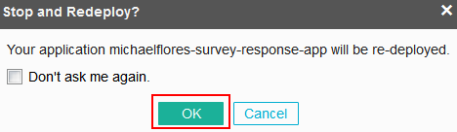
Now that we’ve fixed our app.js and form.html files, let’s redploy our app!
Click on the white play arrow to redeploy your application to Bluemix!
Click Ok

Slide 16

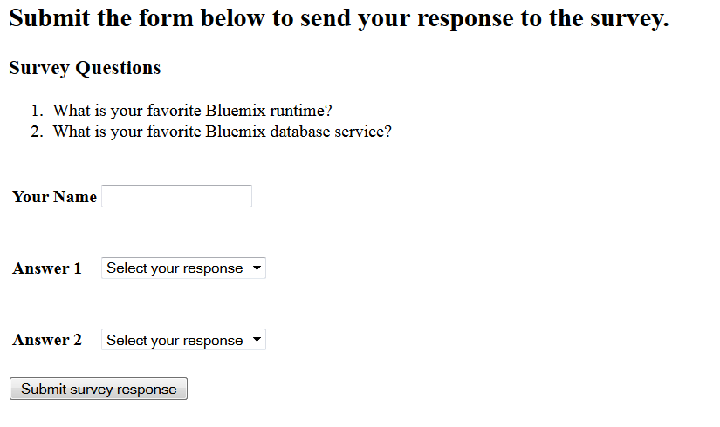
Now that’s what I’m talking about! Way to go!
When the circle turns green and the text bar says (running: normal), our app has finished redeploying!
To see your app, click on the white square with an arrow on it. This will open up a new web page directed to your app.

Slide 17
To vote in the survey, you have to provide your name, and answers to both questions.
There’s no partial credit, so without two answers, the server won’t count a vote.

Slide 18
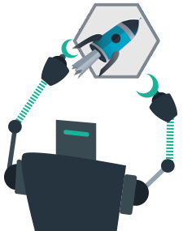
What will YOU build next?

